Slide 1
Project
“CD Portals point”
ALL THE NECESSARY PORTALS IN ONE CLICK

Slide 2
Purpose
UBL Manager’s need to have access in multiple portals everyday. It becomes difficult to get the portals when the managers need those badly. Keeping that in mind, we have conducted a project named “ CD Portals Point”. Here anyone can easily get all the daily important portals in one go.

Slide 3


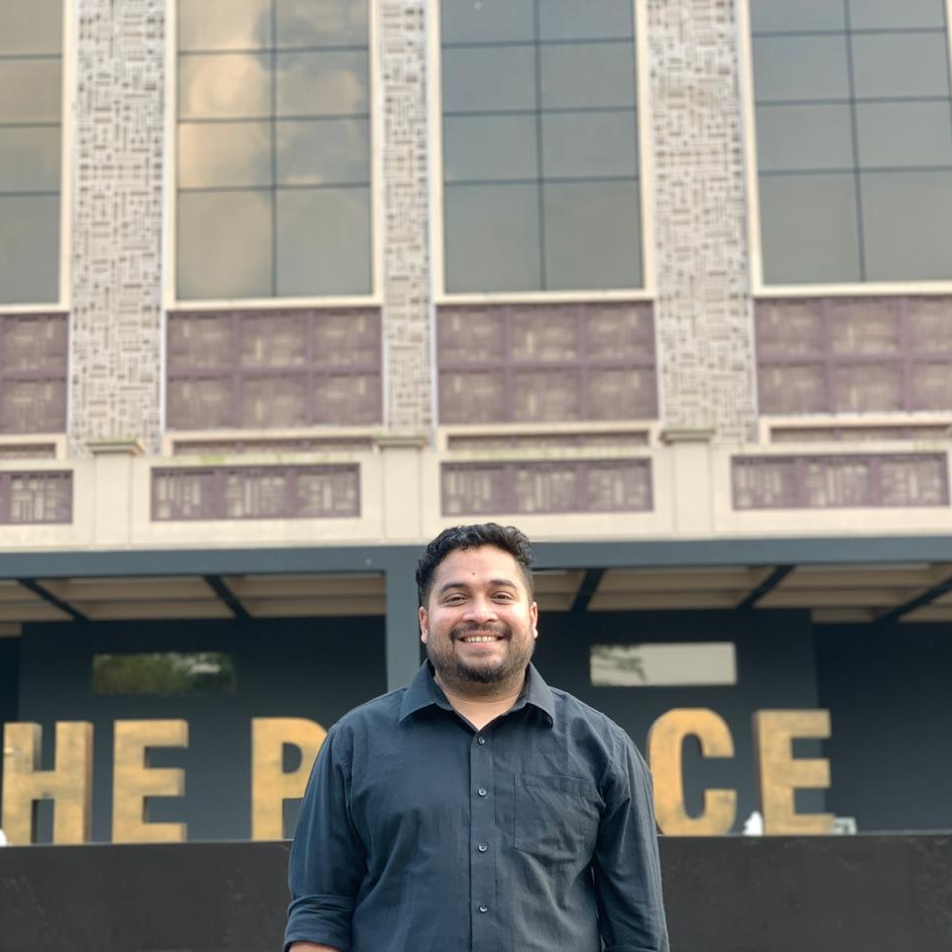
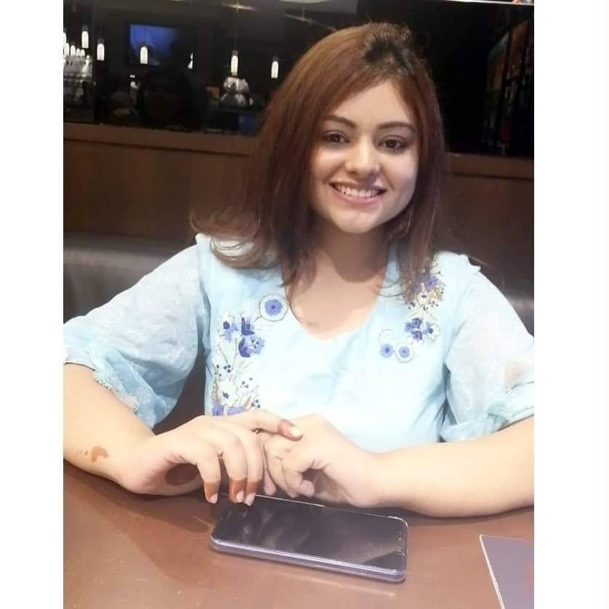
Team Behind The Execution
initiator
Soykot chowdhury
am – Sylhet sales area
Web Developer
Md. Awsaf Abrar
TM - Shayestaganj
Program designer
MD. Refat Ul Haque
TM – Sunamganj
Program designer
Albira Nousin
TM- Moulvibazar Territory

Slide 4
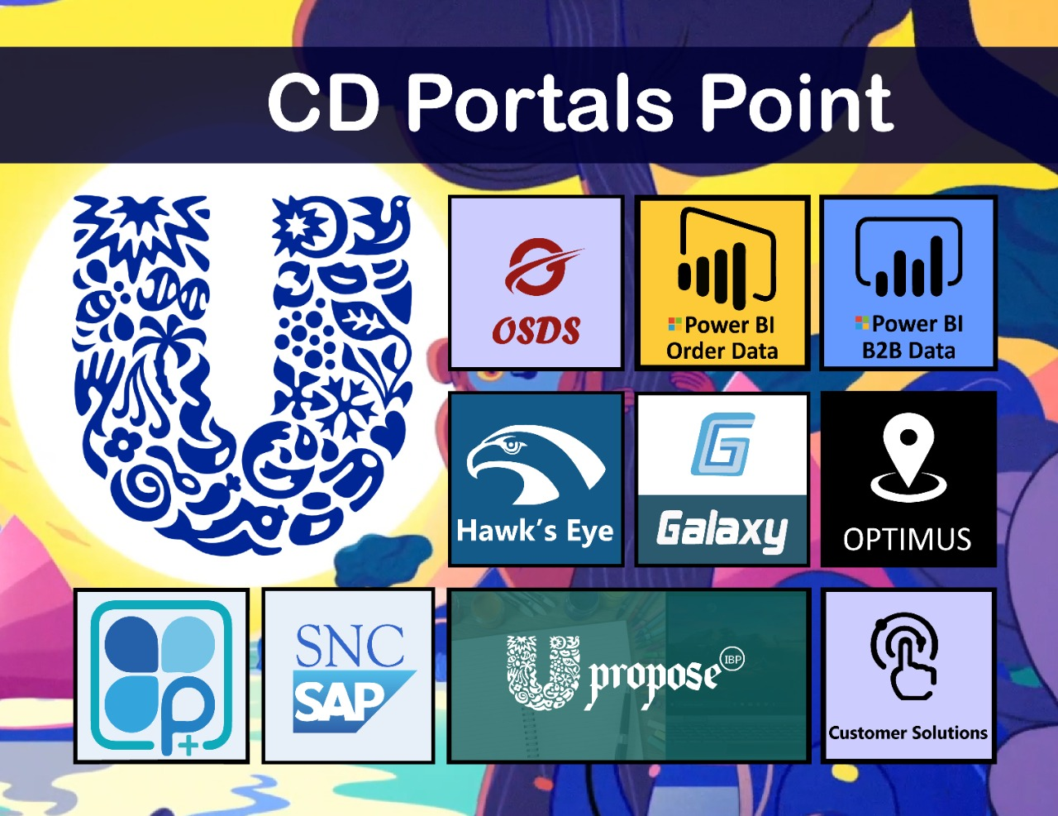
An Overview

Slide 5
Thank you

